Slide 1
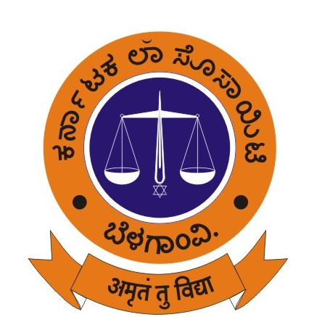

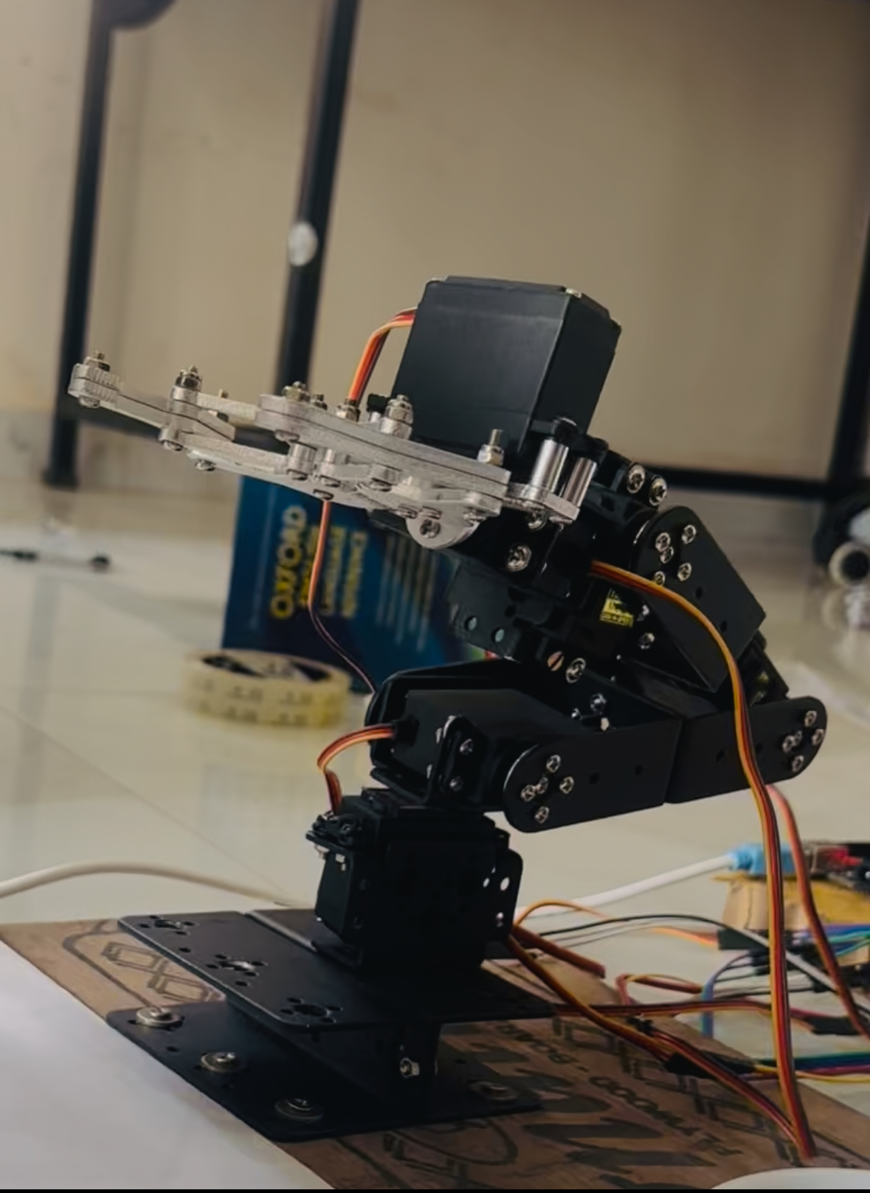
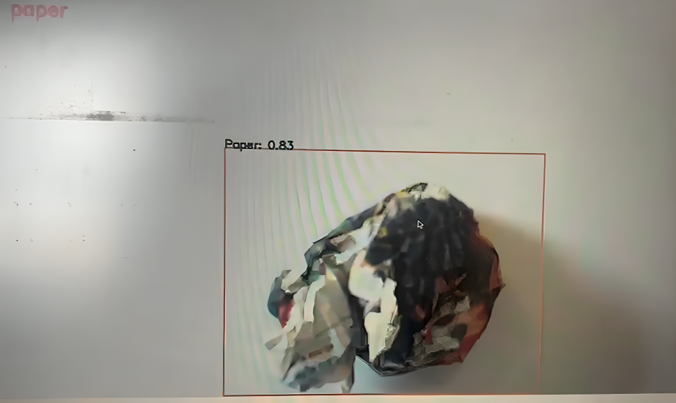
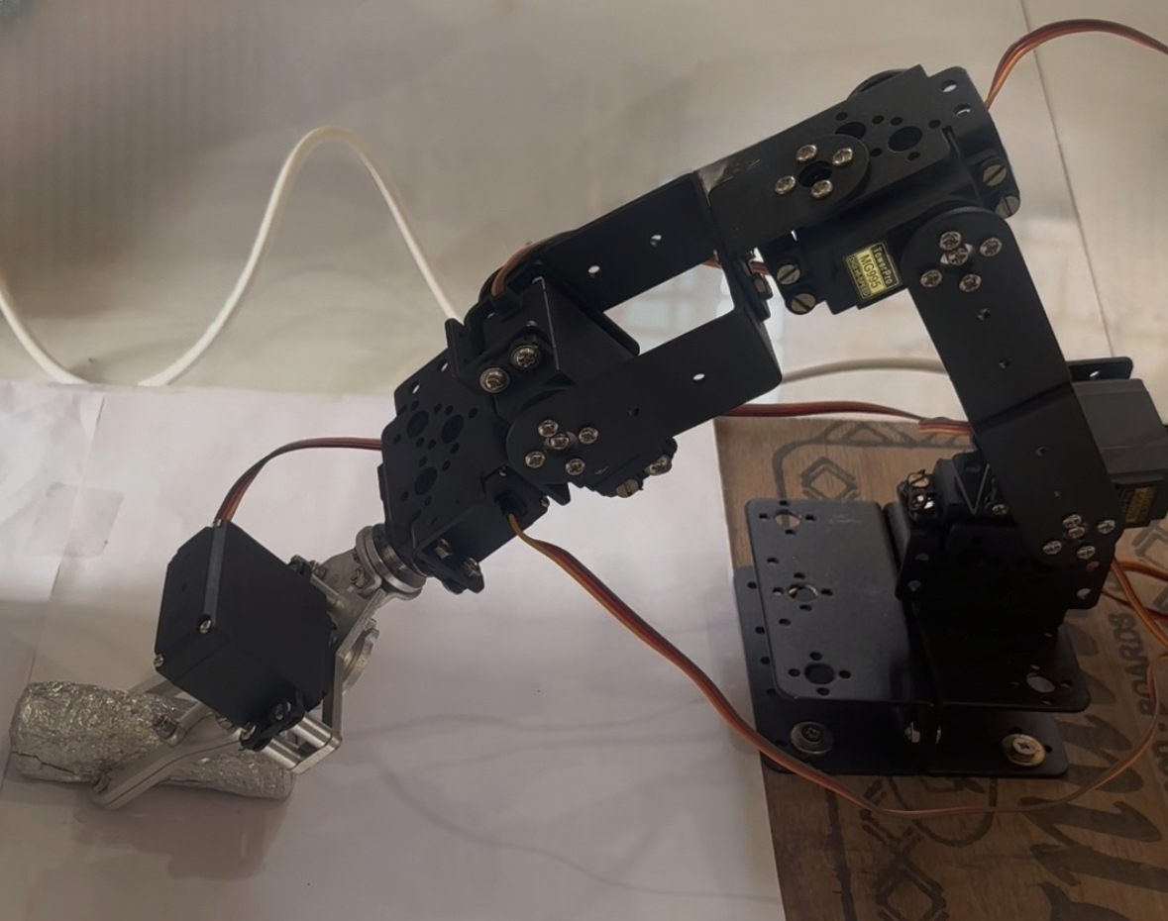
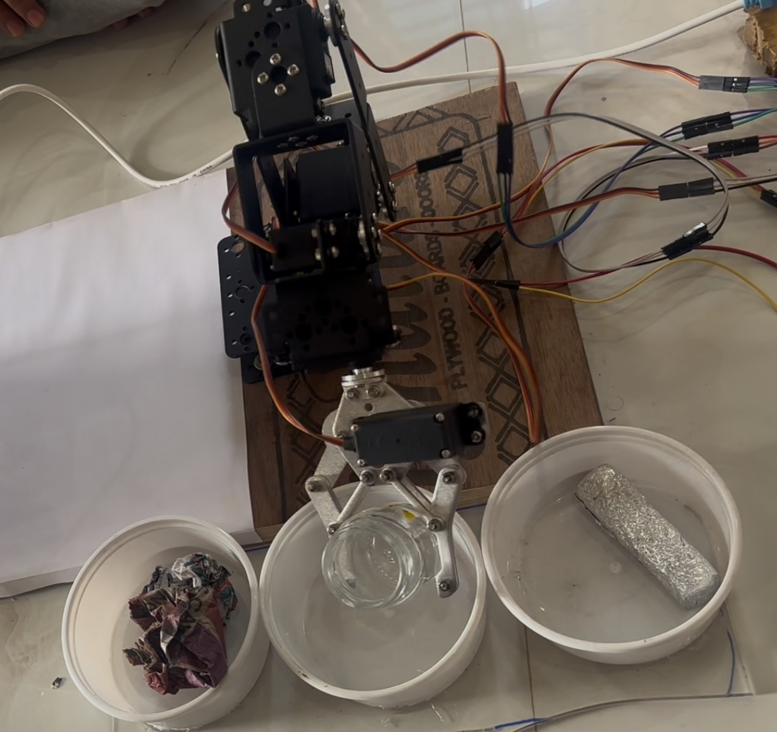
Karnatak Law Society’s
GOGTE INSTITUTE OF TECHNOLOGY
Belagavi
Project Expo-2025
Department of Computer Science and Engineering
Project Title: A robotic arm solution for smarter waste management
Motivation and Objectives:
Our Project Model is an intelligent waste segregation system that combines the power of machine learning and robotics to automate the classification and sorting of Waste. The project aims to address the inefficiencies in traditional waste handling by using an object detection model and a robotic arm to recognize and segregate waste materials such as paper, metal, and glass.
Result Screenshot
Objectives :
To develop a real-time waste classification system using machine learning.
To build a robotic arm capable of sorting waste based on the detected class.
Methodology:
Image Acquisition Module:
  Real-time waste image capture implemented using a Raspberry Pi Camera for continuous input to the classification pipeline.
Waste Classification Module:
  YOLOv8n-based model deployed to detect and classify waste categories with high accuracy and low latency.
Hardware Interface Layer:
  Robotic arm integrated with a 16-bit PCA9685 PWM driver to enable precise servo actuation and synchronized mechanical movement.
Robotic Arm Control Module:
  Automated pick-and-place mechanism programmed to physically segregate detected waste items based on model output.
Results & Discussion:
Successfully implemented a real-time image acquisition module for continuous waste monitoring.
Achieved high-accuracy waste recognition and classification using machine learning techniques.
Implemented automated robotic arm control for precise waste picking and sorting operations.
Developed a fully integrated automated waste segregation system that is efficient, reliable, and suitable for smart waste management applications.
Result Screenshot
Conclusions:
The project successfully integrates real-time waste image acquisition, accurate machine learning based waste classification, and automated robotic arm control to create a fully functional smart waste segregation system. The solution operates efficiently and reliably, ensuring precise detection, picking, and sorting of waste materials. Overall, the system demonstrates strong potential for scalable deployment in modern smart waste management environments, contributing to cleaner, more sustainable, and automated waste-handling processes.
Remarks:
Demonstrates the effective use of machine learning and automation in waste management.
Highlights the system’s potential to support cleaner and more sustainable environments.
Shows how intelligent technologies can improve real-world waste segregation processes.
Represents a meaningful step toward smart and eco-friendly community solutions.
Project Group | Batch no : 52
Students| Abhishek Kudari 2GI22CS003 Bhanu Kamble 2GI22CS038
Chandrakant Acharatti 2GI22CS043 Chetan Ingali 2GI22CS045
Guide Name Dr. Arati S. Shahapurkar
Guide |
2025

